Slide 1


Slide 2
REST - REpresentational State Transfer
Who invented REST?
REST was defined by Roy Fielding, a computer scientist. He presented the REST principles in his PhD dissertation in 2000.
REST CLIENT, RESOURCES
Client — the client is the person or software who uses the API. It can be a developer, for example you, as a developer, can use Twitter API to read and write data from Twitter, create a new tweet and do more actions in a program that you write. Your program will call Twitter’s API. The client can also be a web browser. When you go to Twitter website, your browser is the client who calls Twitter API and uses the returned data to render information on the screen.
Resource — a resource can be any object the API can provide information about. In Instagram’s API, for example, a resource can be a user, a photo, a hashtag. Each resource has a unique identifier. The identifier can be a name or a number.

Slide 3
REST - REpresentational State Transfer
REST stands for REpresentational State Transfer.
It means when a RESTful API is called, the server will transfer to the client a representation of the state of the requested resource.
For example, when a developer calls Instagram API to fetch a specific user (the resource), the API will return the state of that user, including their name, the number of posts that user posted on Instagram so far, how many followers they have, and more.
The representation of the state can be in a JSON format, and probably for most APIs this is indeed the case. It can also be in XML or HTML format.

Slide 4
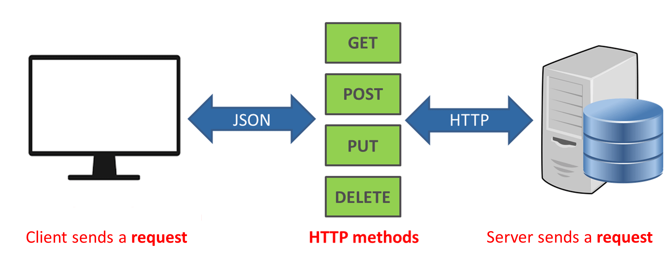
REST - REpresentational State Transfer

Slide 5


